Slide 1
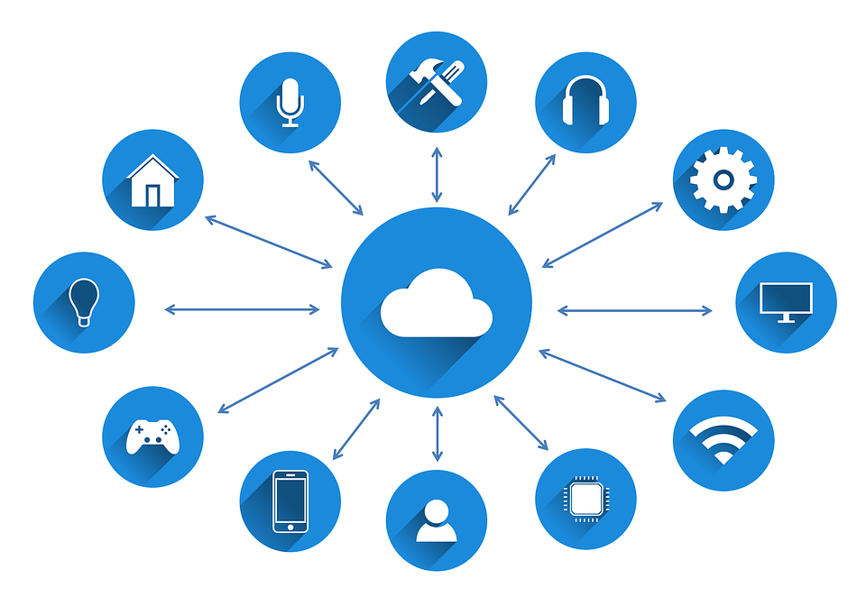
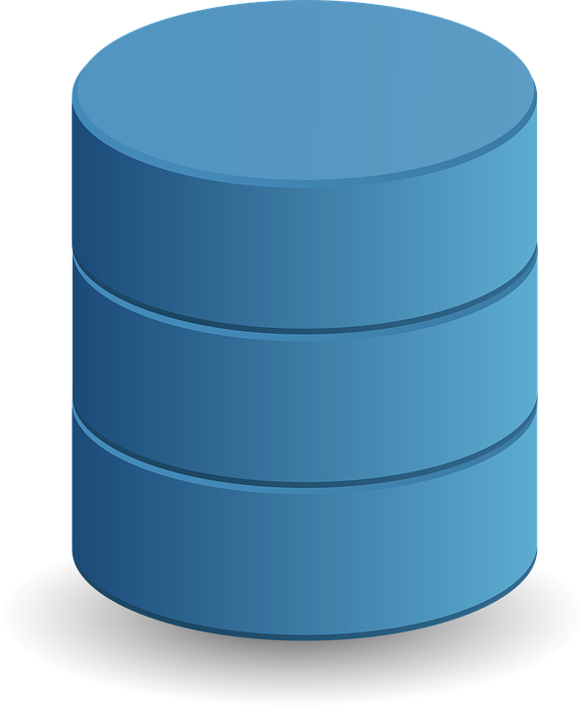
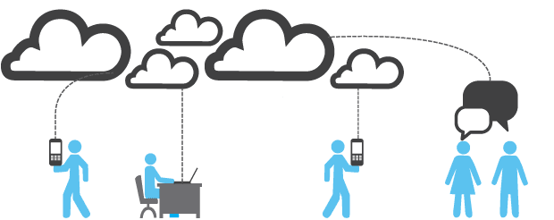

IoT Based Data Storage for Cloud Computing Applications
By
Priyatam Reddy Somagattu
Department of Information Technology
Indian Institute of Information Technology, Allahabad

Slide 2

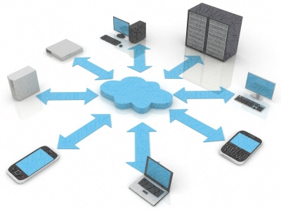
What is Cloud?
Cloud technology is used to store data over a particular network which can be accessed by different devices connected to the same network.
Provision of on-demand computing services using a network based on a pay for use model is called cloud computing.
Types of cloud computing:
Based on deployment model
Public
Private
Hybrid
Based on Service model
Infrastructure
Platform
Software

Slide 3
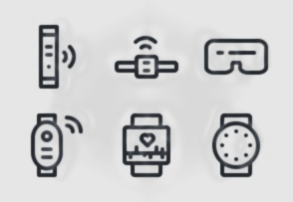
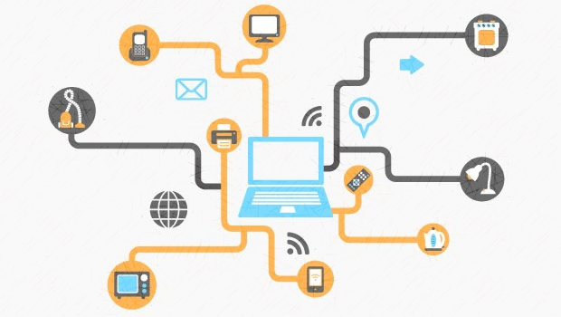
Slide 3
What is Internet of Things?
Physical objects that are connected to one another and are uniquely identified over a network is called internet of things.
Pre-requisites for IoT is Radio Frequency Identification (RFID) tags, sensing nodes, mobile phones etc.
So an IoT ecosystem consists of web-enabled smart devices that have embedded processors, sensors and hardware that can collect, send and manipulate the data obtained.

Slide 4

Motivation to integrate Cloud and IoT
Firstly, we know that cloud is scalable and is convenient to store data.
Secondly, we know the devices like tags and sensors deliver a lot of data which needs to be stored and processed, so cloud is the best storage solution.
The data storage required for IoT should be able to store huge volumes of data along with being able to efficiently scale horizontally.
Notes:
When conducting research, it is easy to go to one source: Wikipedia. However, you need to include a variety of sources in your research. Consider the following sources:
Who can I interview to get more information on the topic?
Is the topic current and will it be relevant to my audience?
What articles, blogs, and magazines may have something related to my topic?
Is there a YouTube video on the topic? If so, what is it about?
What images can I find related to the topic?

Slide 5
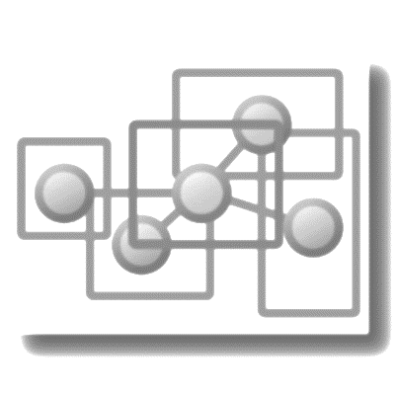
Proposed framework
The data collected is of two types that is structured and unstructured.
Before the different is stored it needs to segregated into structured and unstructured data.
Now for storing unstructured data we use a file repository while we use database management model to store structured data.
Hyper Text Transfer Protocol (HTTP) provides an interface for applications using data from storage in this framework.
A Restful service provision is proposed to support HTTP in the current framework.
Notes:
Once you find your sources, you will want to evaluate your sources using the following questions:
Author:
Who is the author?
Why should I believe what he or she has to say on the topic?
Is the author seen as an expert on the topic? How do you know?
Current:
How current is the information in the source?
When was the source published?
Is the information out-of-date?
Accuracy:
Is the content accurate?
Is the information presented objectively? Do they share the pros and cons?

Slide 6
The architecture of the proposed framework
There are several modules present in this framework:
File repository
Database module
Service module
Resource configuration module
File Repository: This module mainly deals with unstructured data. This basically uses a known file-system which is in this case Hadoop distributed file system (HDFS).
Database module: This focuses mainly on storing structured data. Here we use multiple databases which are relation and NoSQL databases.
Service module: This is responsible of generating automatic Restful service. This module extracts metadata from configuration module and maps it with the data stored.
Resource configuration module: This basically configures data and other related services based on the requirement of the multitenant.
Notes:
After consulting a variety of sources, you will need to narrow your topic. For example, the topic of internet safety is huge, but you could narrow that topic to include internet safety in regards to social media apps that teenagers are using heavily. A topic like that is more specific and will be relevant to your peers. Some questions to think about to help you narrow your topic:
What topics of the research interest me the most?
What topics of the research will interest my audience the most?
What topics will the audience find more engaging? Shocking? Inspiring?

Slide 7
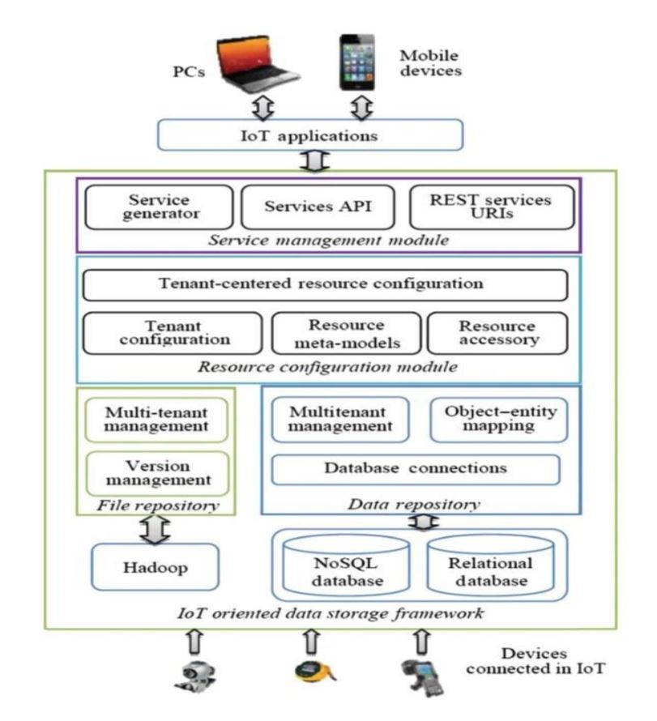
Architecture of the proposed framework
Notes:
Now, that you have narrowed your topic, you will want to organize your research in a structure that works. There are some common organizational patterns based on the kind of research you are doing.
Organizational Structures:
Cause and Effect- this kind of structure is great for explaining the causes and effects of a topic
Compare and Contrast- in this pattern you highlight the similarities and differences of the topic
Explain process- this structure is great for outlining a series of steps to follow;
Definition- if you want to make sure your audience understands what something is using illustrations, meanings, clarifying misconceptions, you may want to use this structure
Classification- a common organizational structure is grouping like topics or facts from the research together. For instance, in the internet safety about social media apps, you may organize the research where you look at each social media app one at a time

Slide 8

Implementation of the proposed framework
We can see the implementation of this framework by a flowchart which shows the flow of data. This mainly involves identification of data and the type of structure.
The database management model looks into the storage aspect of the data collected from the devices. The major techniques used here are object-entity mapping and query adapting.
There is also file repository model which deals with storing unstructured data.
We use database management model and file repository to store data on a local server and then send data to the cloud rather than sending it every second directly.
Notes:
After you’ve done your research, it’s time to put your presentation together. The first step in the process is to introduce the topic. This is a great time to connect your topic to something that your audience can relate. In other words, why should they listen to all the information you will be sharing in your research presentation? What is in it for them? You may also want to include a graphic or image to grab their attention.
Feel free to duplicate this slide by right-clicking on this slide in the slides pane to the left and select Duplicate Slide.
The next step in your presentation is to state your claim or topic clearly. Your teacher may even call this your thesis. As you state your thesis, you may find that this layout is not the best layout for your claim or topic. You can change the layout by clicking the drop-down menu next to the Layout in the Slides menu section. You can choose Two Content, Comparison, or Picture with Caption. Note: A different layout might change the look of the icons on this page.
You will also want to state your facts. You have done the research now share some of the interesting facts with your audience. Facts do not have to be boring; you can communicate facts in a variety of ways by going to the Insert Tab. In the Insert tab you can:
Insert pictures from your computer or online.
Add a chart
Create some SmartArt
Insert a variety of icons to help your facts come to life. Note: You can change the color of the icons by selecting the icon and then click on the Format tab and then Graphics Fill. From there, you will choose a color from the list or choose More Fill Colors to give you more options.
Since this research presentation is a result of your hard work and searching, you want to make sure you support the claims or points in your presentation with facts from your research findings. Make sure you give the author proper credit for helping you share your ideas. If one of your sources has a video that is relevant to your topic, you can add the video as added support. Keep in mind the length of the video and the amount of time you have for your presentation. For a 5 minute speech, the video should be no longer than 30 seconds.
Questions to consider:
How will you state the author of the source?
Will you need to cite the source on the slide?
What are some ways you can engage your audience so they feel like they are a part of the presentation? Some ideas to consider is by taking a quick poll like: by a show of hands, how many of you think school uniforms are a way to cut down on bullying? Another suggestion is to have them hold up a certain number of fingers to see if they agree or disagree. Finally, you can share a story that the audience can relate to that makes them laugh.
After all the applause, your audience may have some questions. Be prepared to answer some of their questions by making a list of questions you think they might ask. You may also want to share the presentation with them by providing the link to your presentation, if they want more information.

Slide 9
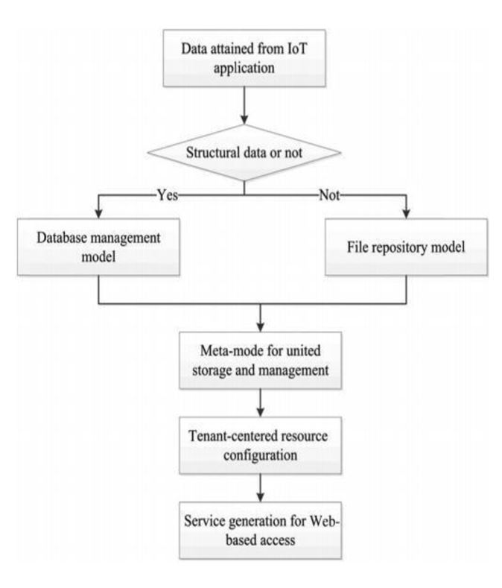
Flowchart of the approach

Slide 10
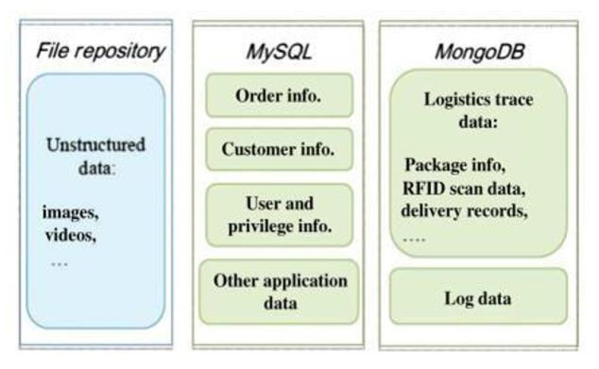
Example of implementation of the database model and file repository model

Slide 11
Conclusion and future work
Industrial application sector is hugely impacted by both IoT and cloud technologies.
Therefore an efficient cloud based data storage framework can increase efficiency of IoT in terms of data storage and management services.
In this proposed framework we have used limited adapters. In future, authors can optimize the framework’s performance as new avenues of applications emerge.
The merger of cloud and IoT technology in data management is likely to be used in multiple new applications.

Slide 12


